Slide 1
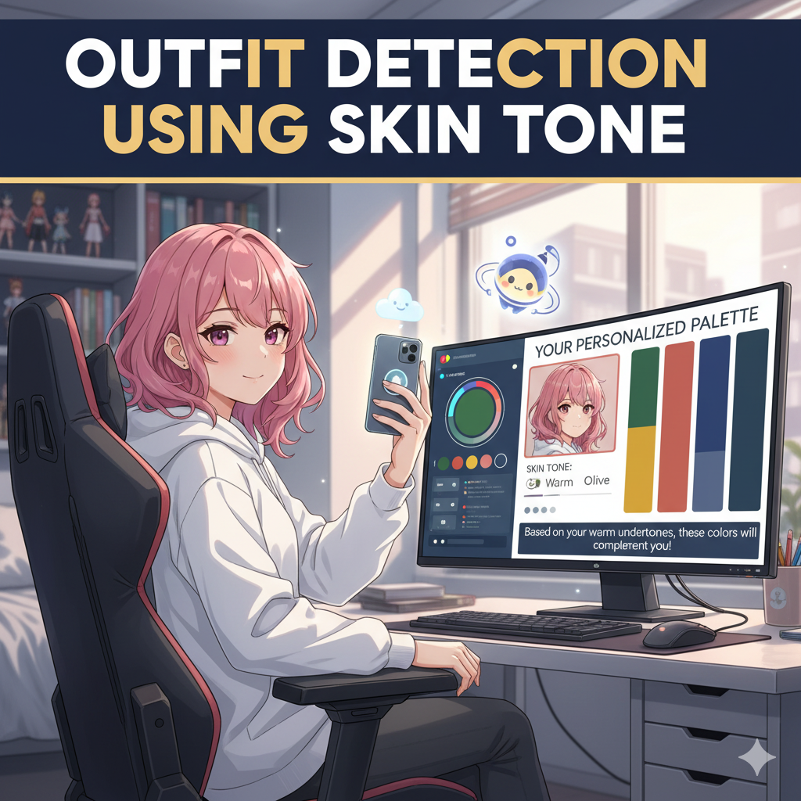
OUTFIT PREDICTION USING SKIN TONE
team:
2303A51L89 naGanishith
2303A51L84 abhiram
2303A51L96 karthikeya
2303A51L16 goutham
2303A51L60 Nikhil
Project guide:
y. Arjun sagar

Slide 2
Progress on Implementation
The major parts of implementation were divided into three parts: 1. identify the face
2. identify the skin tone
3. identify the matching dress to that skintone
These three are the major steps in our project.
We have already completed the 1st and 2nd steps.
We successfully implemented face detection and skin tone identification.

Slide 3
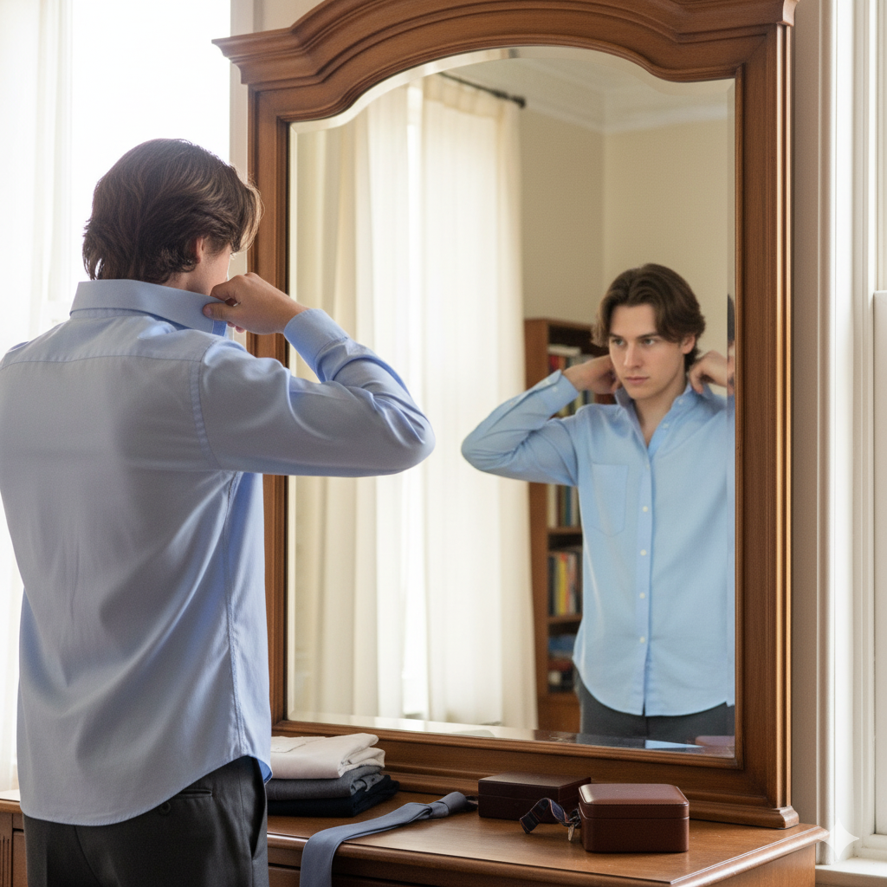
Methodology/Approach Adopted
Image Input
Face Detection
Skin Segmentation
K-Means Clustering
Tone Mapping
Final Output
Generate results (tone label, visualization, and CSV report).
Match the dominant color with a predefined skin tone scale.
Group skin pixels to find the dominant skin color.
Extract only skin pixels from the detected face area.s
Detect face regions using OpenCV Haar Cascade.
Provide the source image

Slide 4
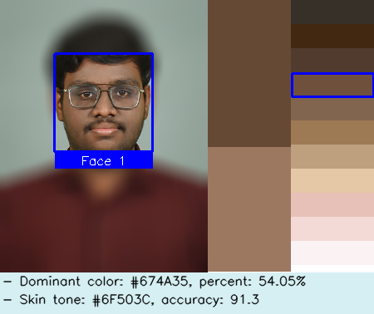
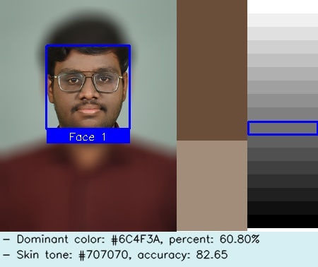

Results/Outputs

Slide 5
NEXT STEP
Our goal is to build a comprehensive system that recommends the perfect dress for each skin tone.
Next Phase: Dress Data Collection
We will collect a diverse dataset of dresses for each skin tone.
This will involve gathering images and data to create a reliable database for our recommendation engine.
Final Phase: Prediction and Recommendation
We will develop a prediction model to use the classified skin tone as input.
The model will output a prediction of the most suitable dresses from our collected dataset.
This final step will complete the project, providing a full solution from skin tone analysis to personalized dress recommendations.

Slide 6
CONCLUSION
We have successfully completed the core functionality of our project: skin tone identification.
This was achieved by implementing a robust methodology that includes:
Face detection using OpenCV Haar Cascade.
Skin segmentation and dominant color extraction using K-Means clustering.
Mapping the dominant color to a predefined skin tone scale.
The system is now fully capable of processing an image and classifying the skin tone of each detected face.

Slide 7
THANK YOU

